Slide 1
Flask

Slide 2
What is Flask?
Flask is an API of Python that allows us to build web applications. It was developed by Armin Ronacher.
Flask’s framework is more explicit than Django’s framework and is also easier to learn because it has less base code to implement a simple web application.
Flask Python is based on the WSGI(Web Server Gateway Interface) toolkit and Jinja2 template engine.

Slide 3
Advantages of Flask
Flask is a lightweight backend framework with minimal dependencies.
Flask is easy to learn because its simple and intuitive API makes it easy to learn and use for beginners.
Flask is a flexible Framework because it allows you to customize and extend the framework to suit your needs easily.
Flask can be used with any database like:- SQL and NoSQL and with any Frontend Technology such as React or Angular.
Flask is great for small to medium projects that do not require the complexity of a large framework.

Slide 4
Working
Create a Python Script with .py extension
from flask import Flask
app = Flask(__name__)
@app.route('/’)
def index():
return "Hello, World!“
if __name__ == '__main__':
app.run(debug=True)

Slide 5
Working
The Flask route / calls the index() function.
app = Flask(__name__) this creates a new flask web application instance.
@app.route('/'): This line is a decorator that tells Flask to trigger the index() function when someone accesses the root URL (/).
def index(): This is the function that will be called when the root URL is accessed.
return "Hello, World!": This line defines what the function returns, which in this case is a simple "Hello, World!" message.
if __name__ == '__main__’:
app.run(debug=True) This code block checks if the script is being run directly (not imported as a module) and starts the Flask development server with debugging enabled.

Slide 6
Working
To install flask
Pip install flask
mysql-connector-python for connecting to the MySQL database.
Flask for creating the web application.
pip install mysql-connector-python Flask

Slide 7
Running the Application:
Run the script with python script_name.py.
Open a web browser and go to http://127.0.0.1:5000/ to see the data displayed in a table.

Slide 8
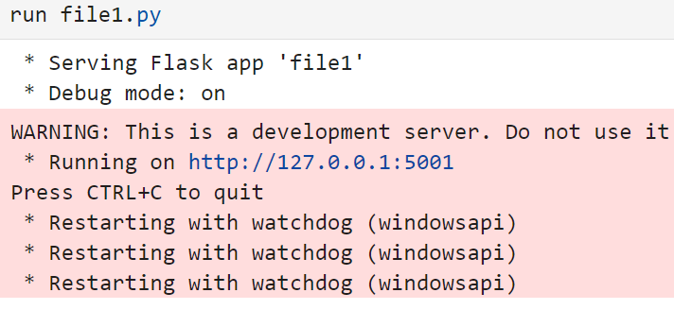
By clicking on it hello world will be printed

Slide 9
from flask import Flask, render_template
app = Flask(__name__)
@app.route('/’)
def home():
return render_template("index.md")
if __name__ == '__main__':
app.run()

Slide 10
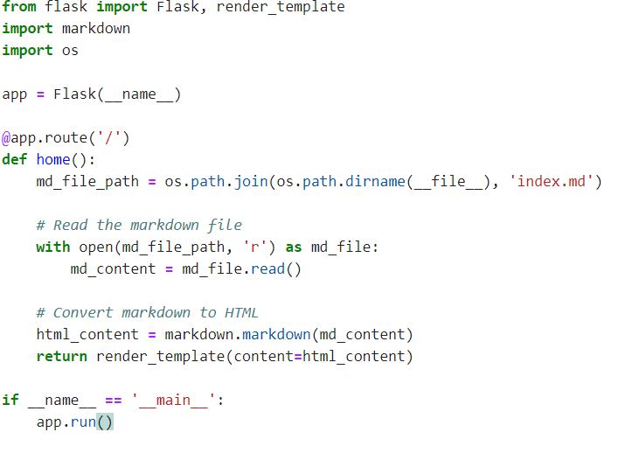

Slide 11
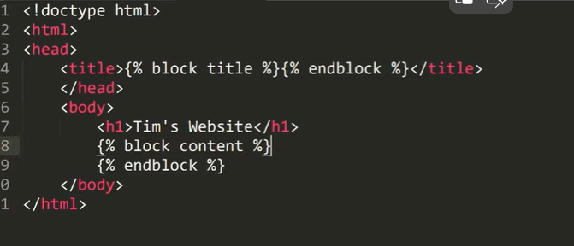

Slide 12
